Slide 1
Data and Algorithm 9
Please turn your phone to silent mode.
Chulalongkorn University
School of Integrated Innovation
Fall 2023
Marko Niinimaki Marko.N@chula.ac.th

Slide 2
Today’s main topics
Where is data? In programs/files/databases/blockchains...
More hash functions and hash tabels.
What are blockchains? What kinds of data structures and algorithms do they need?
Linked Lists.
Blockchain/cryptocurrency example.
Assignments: Data visualization, bitcoin's mining method.
How is Bitcoin mined: ASIC Application-Specific Integrated Circuit

Slide 3
Hash functions and hash tables
We want to quickly check if we have this “digital object” in our collection.
Let's have a list of fixed size (an array). For each digital object that we want to put in the array, let's compute its hash function value .. and "fit" it in the array.
Example: Array of strings, size 10, index 0 .. index 9.
import hashlib
hexval = hashlib.sha256(b"Hello World").hexdigest()
intval = int(hexval, 16)
pos = intval % 10
The position for "Hello World" in the array is 4.

Slide 4
Hash functions and hash tables
0​ | 1​ | 2​ | 3​ | 4​ | 5​ | 6​ | 7​ | 8​ | 9​
​ | ​ | ​ | ​ | Hello World​ | ​ | ​ | ​ | ​ | ​
But we'll have a problem when there's another string whose hash value % array size is 4, too.
Solution: use a list of strings at each index instead of just a string.

Slide 5
Hash functions and hash tables
0​ | 1​ | 2​ | 3​ | 4​ | 5​ | 6​ | 7​ | 8​ | 9​
​x | ​x | ​x | ​x |  | ​x | ​x | ​x | ​x | ​x
Hello world

Slide 6
Hash functions and hash tables
Application of hash tables: Python dictionaries.
We could create our own implementation (let's not). It could look like this:
class HashTable(Generic[T], tablesize) # We'll cover what "generic" means later
myhashtable = HashTable[string](100) # create a hash table for 100 strings

Slide 7
Hash functions and hash tables
Application of hash tables: Python dictionaries.
Luckily Python has hash tables as a built in data type called a dictionary.
Moreover, Python has a hashing function hash() that applies to almost anything:
https://www.geeksforgeeks.org/python-hash-method : Python hash() function is a built-in function and returns the hash value of an object if it has one. The hash value is an integer which is used to quickly compare dictionary keys while looking at a dictionary.
x =1
print(hash(x))
1
x= "hello"
print(hash(x))
6470543067838380530

Slide 8
Hash functions and hash tables
Application of hash tables: Python dictionaries.
Let's consider finding the most frequent word in a file again. A word's frequency could be a mapping like "love" -> 13 meaning the word love appeared 13 times.
With Python we can just write:
myfreqs = {} # introduce a Python dictionary
myfreqs["love"] = 13 # make a mapping
print(myfreqs["love"])

Slide 9
Hash functions and hash tables
Application of hash tables: Python dictionaries.
Let's consider finding the most frequent word in a file again. A word's frequency could be a mapping like "love" -> 13 meaning the word love appeared 13 times.
With Python we can just write:
myfreqs = {} # introduce a Python dictionary
myfreqs["love"] = 13 # make a mapping
if "love" in myfreqs: # is there a mapping for the word?
print(myfreqs["love"])

Slide 10
Hash functions and hash tables
Application of hash tables: Python dictionaries.
How would we put every word's frequency in the dictionary? Like in your previous example, we first put all the words of the file (text) into a list called words.
myfreqs = {} # introduce a Python dictionary
for word in words:
if word in myfreqs:
myfreqs[word] = myfreqs[word] + 1
else:
myfreqs[word] = 1

Slide 11
Hash functions and hash tables
Application of hash tables: Python dictionaries.
Is this faster that finding the frequencies using nested for loops?
Finding the most frequent word in Pride and Prejudice (~ 125 000 words)
For loops: 300 seconds
Dictionary: 0.2 second
And our new example in https://github.com/manzikki/chulads

Slide 12
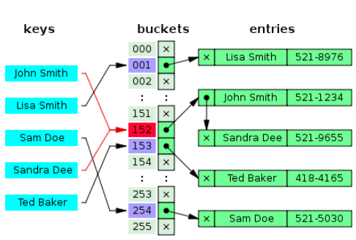
Hash tables
Where is data? In programs/files/databases/blockchains...
Hash table operations time complexity?
Adding O(1)
Find operation O(n) ????
But practically constant

Slide 13
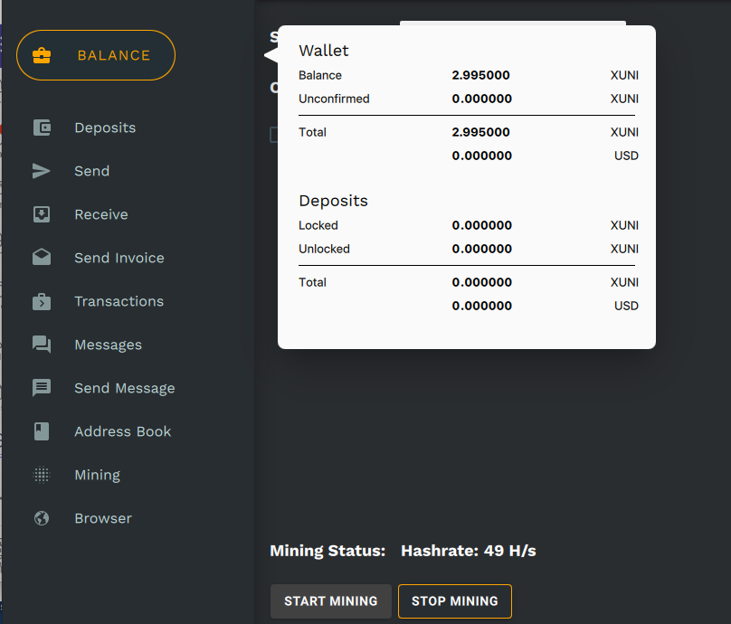
Today’s main topics: cryptocurrency
Where is data? In programs/files/databases/blockchains...
Demonstrating this cryptocurrency does not mean promoting it, or promoting cryptocurrencies in general.
We use it because it is possible to mine it using a CPU = it has very little value.
XUNI's wallet is now considered a virus by Windows, so we'll try another coin.

Slide 14
Python lists
Where is data? In programs/files/databases/blockchains...
https://www.youtube.com/watch?v=Ast5sKQXxEU Python linked lists in 5 min (and has more operations that we will cover).

Slide 15
Python lists
Where is data? In programs/files/databases/blockchains...
https://runestone.academy/ns/books/published/pythonds3/BasicDS/ImplementinganUnorderedListLinkedLists.html?mode=browsing
An array is a contiguous block of memory.
Accessing any element is very fast because the CPU can quickly compute the offset based on the index. Example: an integer is 4 bytes. An array A of 10 integers (that happens to be sorted):
Access the element at index 5 means "get an integer (4 bytes) at the memory address that is the beginning of the array + 5 * 4 bytes. O(1) operation.
0 | 1 | 2 | 3 | 4 | 5 | 6 | 7 | 8 | 9
5 | 8 | 12 | 13 | 20 | 22 | 25 | 28 | 31 | 36

Slide 16
Python lists
But what happens if we need to add new elements in the beginning?
The "safe" way is to allocate memory that is 1 element (4 bytes in our case) bigger and then copy the elements from the old array.
This is O(n). Can we make it faster?
0 | 1 | 2 | 3 | 4 | 5 | 6 | 7 | 8 | 9
5 | 8 | 12 | 13 | 20 | 22 | 25 | 28 | 31 | 36
0 | 1 | 2 | 3 | 4 | 5 | 6 | 7 | 8 | 9 | 10
4 | 5 | 8 | 12 | 13 | 20 | 22 | 25 | 28 | 31 | 36

Slide 17
Python lists
Use a "list", not an array.
A list is a dynamic data structure: can shrink and grow, elements can be added in the middle. The circles represent data that can be e.g. integers. Nodes have data and a pointer. We call it “next”.
List L. The arrows are pointers to the next member of the list. Additionally we want to point the first member .. and very often to the last member, too.
NB: The textbook example has a "head" node. We'll cover that soon.

Slide 18
Python lists
L
5
4
How to add an "element" (but we call them nodes) in the beginning?
Let’s call the red arrow “List pointer”. Copy it.
Allocate a new node. Put the copy of the list pointer to the new node’s next pointer. Make the List pointer point to the new node.

Slide 19
Python lists
L
5
4

Slide 20
Python lists
L
4
5
30

Slide 21
What next?
Exploring a blockchain/cryptocurrency. https://www.blockchain.com/explorer
Size of the blockchain? Bitcoin: 516.5 GB, Demo (Ultranote XUNI) 1.6 GB
Wallets? A software that has a copy of the blockchain (or parts of it) and lets one do transactions.
Pools? A mining pool is a collection of miners. Miners submit their hashes to the pool. The block reward is shared among the miners.
Online wallets? A simplified wallet that does not have the full blockchain.
Smart contracts? Agreements based on blockchain with conditional transfer.
What is a NFT? Non-fungible token. The ownership can be recorded in the blockchain. https://www.theguardian.com/technology/2022/apr/14/twitter-nft-jack-dorsey-sina-estavi
A peer to peer network. Not centralized, each peer has a copy of the blockchain.

Slide 22
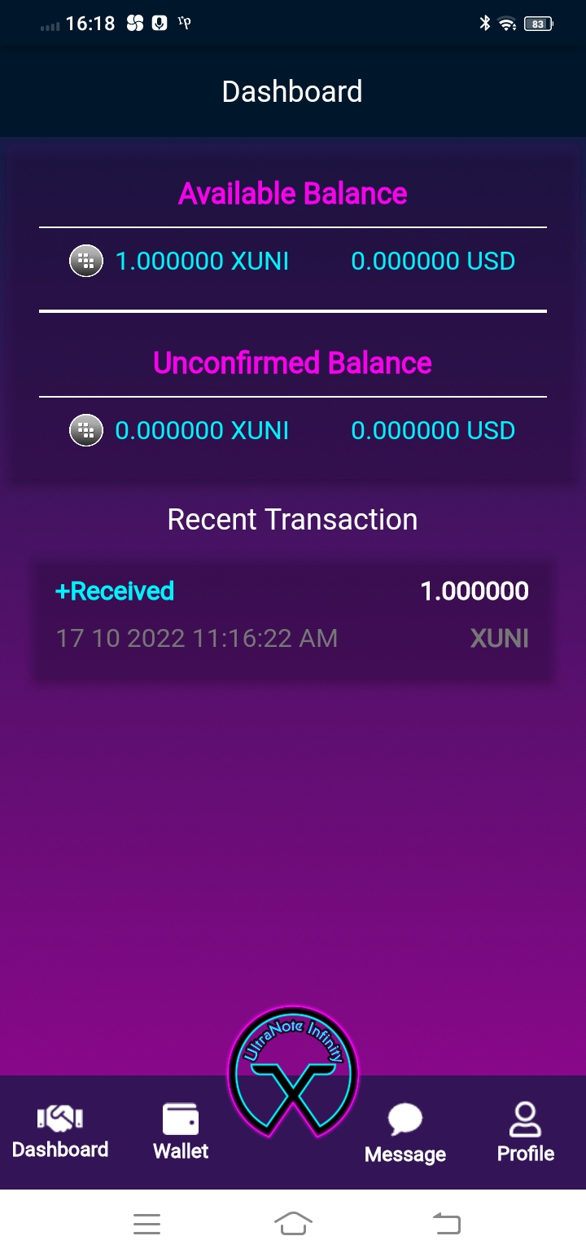
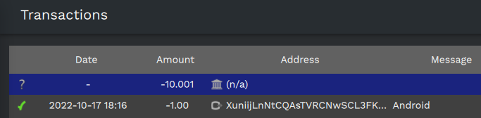
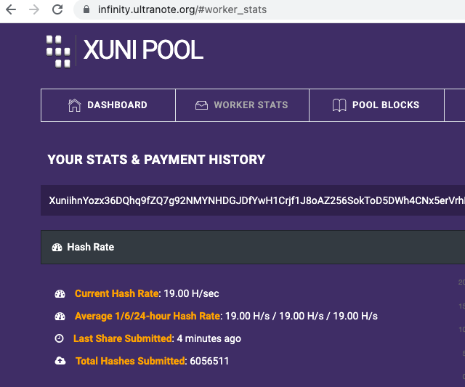
Oct 19: Demos of a cryptocurrency
< Sent from my Mac wallet
> Received by my Android wallet.
< My Mac mining statistics
Current val of all of xuni: 3,060,014 * 0.00018 = 550.80 USD

